Slide 1
Trustpilot Causal Impact Analysis
??/11/2022
Presented by: Data Planning @ MG OMD

Slide 2
01
Introduction

Slide 3
Introduction
Heading into this campaign, Trustpilot was in a strong position to launch a first brand campaign
The campaign ran from 2nd October to 13th November
The B2C campaign consisted of TV, VoD, OOH, YouTube and Social
The B2B campaign consisted of Social and Display
The primary KPI this campaign is demo requests
Free sign-ups have also been measured as a secondary KPI
This analysis shows that, taken together, the brand campaign in Italy was extremely successful
The campaign drove a 322% increase in Demo Requests
And a 31% increase in free sign-ups

Slide 4
02
Methodology

Slide 5
Methodology
We are trying to estimate the causal effect of an intervention (Trustpilot Italy Brand Campaign) on the primary KPI (demo requests) and the secondary KPI (free sign-ups)
i.e. how many additional demo requests and free sign-ups were delivered by the campaign
We use a Bayesian structural time-series model to predict the counterfactual case (i.e. what might have happened if the campaign didn’t take place)
This counterfactual case is a weighted average of equivalent Trustpilot markets to create a similar control case for Italy
We compare Italy against a set of control cases showing similar performance and trends in the pre-campaign period:
Austria
Switzerland
Denmark
France
Sweden

Slide 6
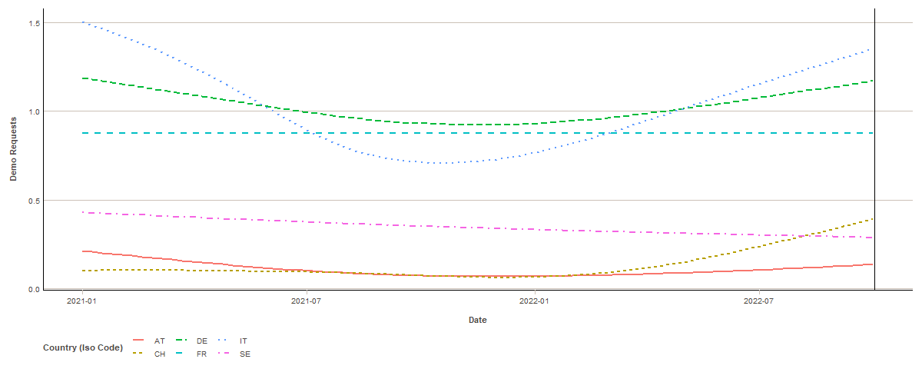
Demo Requests (pre-campaign)

Slide 7
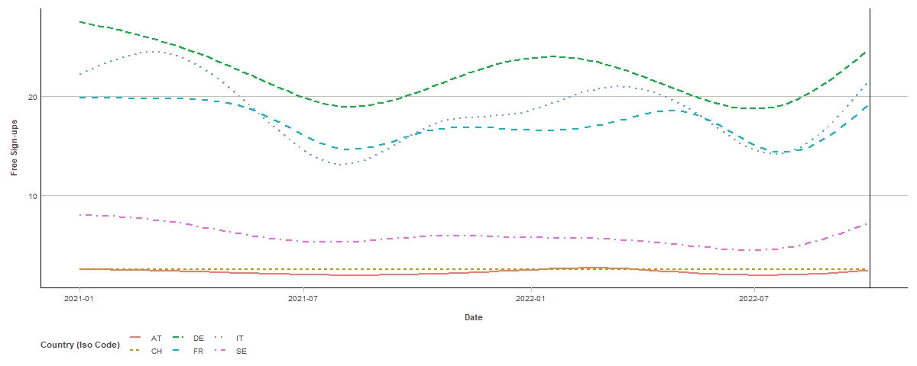
Free Sign-ups (pre-campaign)

Slide 8
03
Results

Slide 9
Demo Requests

Slide 10
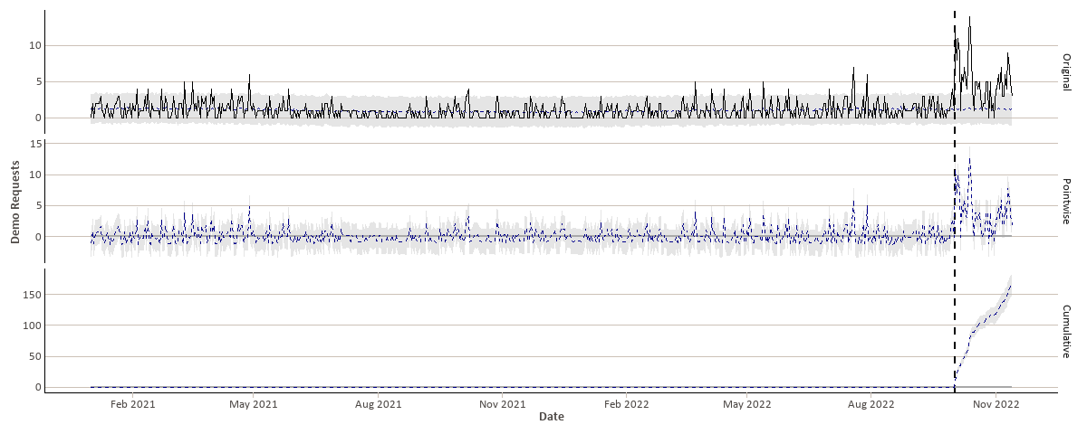
Demo Requests

Slide 11
Results
During the campaign period, in the absence of the campaign, we would have expected an average of 1.2 demo requests per day
95% confidence interval: [0.77, 1.6]
However, during this period, the actual average was 5 demo requests per day.
We can therefore estimate that the average causal effect was 3.9 demo requests per day.
Overall, 217 demos were requested during the campaign period.
Of these, we would have expected 51.4 demo requests in the absence of the campaign
95% confidence interval: [33.32, 68.9].
Therefore, we can estimate the total causal effect of the campaign as 165.6 demo requests.
 | Daily Average | Cumulative
Actual | 5 | 217
Prediction (s.d.) | 1.2 (0.21) | 51.4 (9.04)
95% Confidence Interval | [0.77, 1.6] | [33.32, 68.9]
Absolute Effect (s.d.) | 3.9 (0.21) | 165.6 (9.04)
95% Confidence Interval | [3.4, 4.3] | [148.1, 183.7]
Relative Effect (s.d.) | 322% (18%) | 322% (18%)
95% Confidence Interval | [288%, 357%] | [288%, 357%]

Slide 12
Results
In relative terms, the campaign led to an increase in demo requests of 322%
The probability of these results being explained by a causal effect is 99.90% (conversely, the probability of these results being explained by chance is 0.10%).
Therefore, the causal effect can be interpreted as being statistically significant.
 | Daily Average | Cumulative
Actual | 5 | 217
Prediction (s.d.) | 1.2 (0.21) | 51.4 (9.04)
95% Confidence Interval | [0.77, 1.6] | [33.32, 68.9]
Absolute Effect (s.d.) | 3.9 (0.21) | 165.6 (9.04)
95% Confidence Interval | [3.4, 4.3] | [148.1, 183.7]
Relative Effect (s.d.) | 322% (18%) | 322% (18%)
95% Confidence Interval | [288%, 357%] | [288%, 357%]

Slide 13
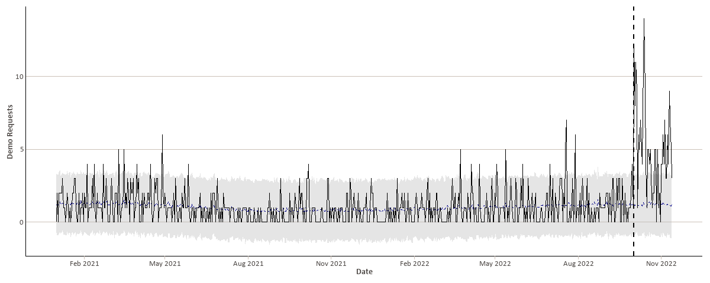
Original Data

Slide 14
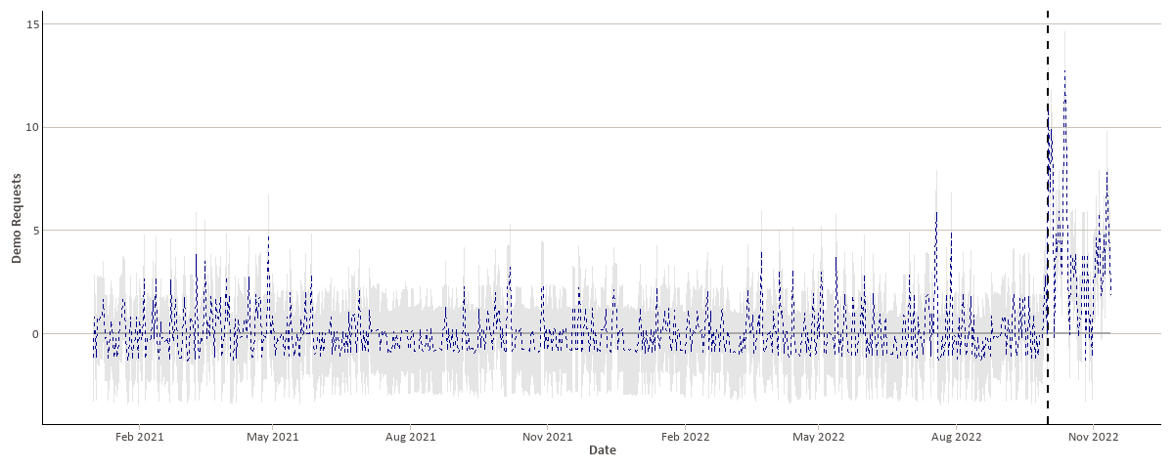
Pointwise Results

Slide 15
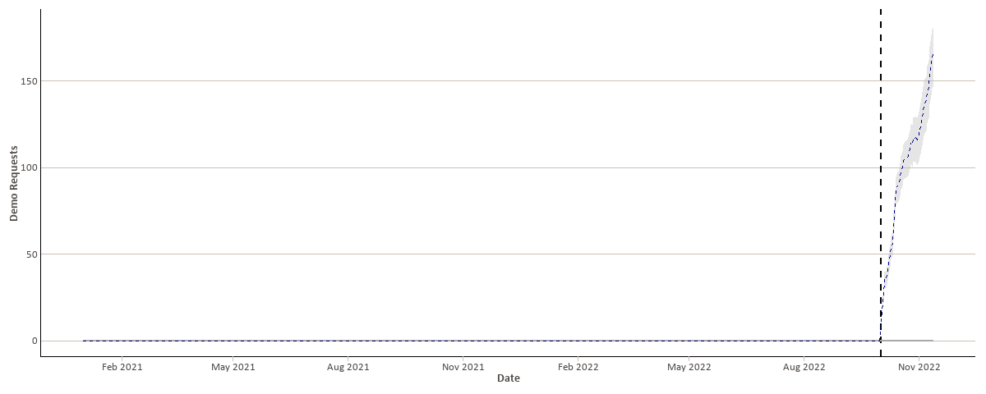
Cumulative Results

Slide 16
Free sign-ups

Slide 17
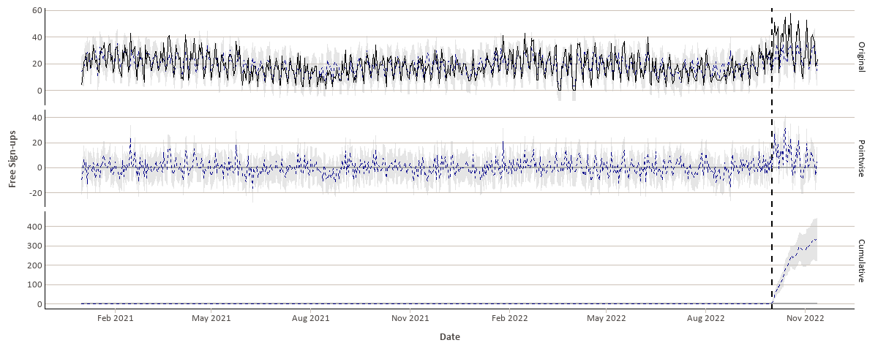
Free sign-ups

Slide 18
Results
In the absence of the campaign, we would have expected an average of 26 free sign-ups per day
95% confidence interval: [23, 28]
The campaign delivered an average of 34 free sign-ups per day
This suggests that the effect of the campaign was an increase of 7.9 free sign-ups per day
This is equivalent to an increase of 31%
Across the campaign, this is equivalent to an additional 337.6 free sign-ups
95% confidence interval: [222.4, 453]
In this case, the probability of observing these results by chance is very small (p = 0.001), hence these results are statistically significant.
 | Daily Average | Cumulative
Actual | 34 | 1444
Prediction (s.d.) | 26 (1.4) | 1106 (59.4)
95% Confidence Interval | [23, 28] | [991, 1222]
Absolute Effect (s.d.) | 7.9 (1.4) | 337.6 (59.4)
95% Confidence Interval | [5.2, 11] | [222.4, 453]
Relative Effect (s.d.) | 31% (5.4%) | 31% (5.4%)
95% Confidence Interval | [20%, 41%] | [20%, 41%]

Slide 19
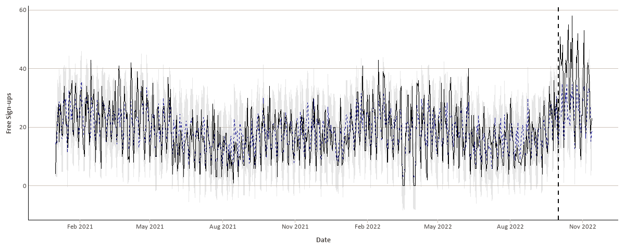
Original Data

Slide 20
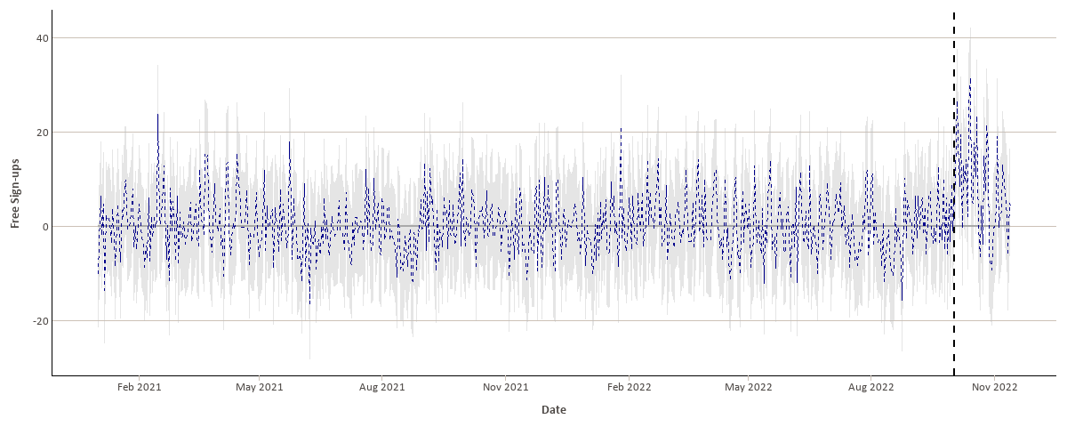
Pointwise Results

Slide 21
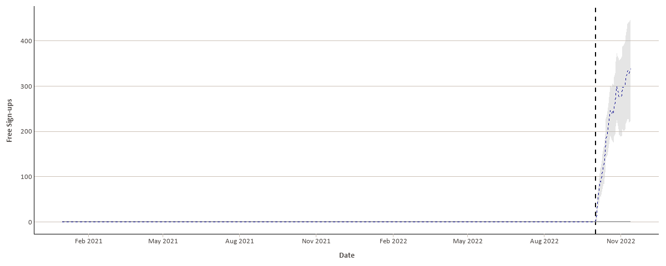
Cumulative Results

Slide 22
04
Conclusion

Slide 23
Conclusions
Across both metrics for this campaign (demo requests and free sign-ups), the Trustpilot Italy campaign was very successful:
322% increase in demo requests
31% increase in free sign-ups
These results show clearly that the Trustpilot brand campaign in Italy drove a significant increase in demo requests and free sign-ups that would not otherwise have happened

